Slide 1

INTEGRATED LIBRARY
MANAGEMENT
SYSTEM
ILMS — Primeasia University
Course:
Database Management System
Submitted To:
Halima Mowla
Department:
CSE, Primeasia University
Date:
13 May 2026

Slide 2
TECHNOLOGIES USED
PHP
HTML
CSS
Server-Side Scripting
Markup & Structure
Styling & Visual Design
• Backend logic & DB queries
• Session management & auth
• REST API & form processing
• MySQL integration for ILMS data
• Page structure & layout
• Forms for book search & borrow
• Tables for member & book lists
• Semantic HTML5 for accessibility
• Responsive layout for all devices
• Styled dashboards & admin panels
• CSS3 animations & transitions
• Consistent UI across all pages
Frontend stack powering ILMS — HTML for structure, CSS for styling, PHP for server-side logic & database integration

Slide 3




INTRODUCTION
BACKGROUND
OBJECTIVES
Libraries traditionally relied on physical registers and card catalogs. This project transitions all operations into a robust relational database system, ensuring data integrity, security, and efficient retrieval for Primeasia University.
Automation
Book issuance, returns & fine calculations
Centralization
Central repository for books & members
KEY PROBLEMS
Search Optimize
High data redundancy & inconsistency
Search by title, ISBN, genre & more
Difficult overdue tracking & fine calculation
Inefficient search mechanisms
Security
Role-based access control (Admin & Member)
No data backup, high physical storage cost

Slide 4
REQUIREMENT ANALYSIS
⚙ FUNCTIONAL REQUIREMENTS
🛡 NON-FUNCTIONAL REQUIREMENTS
User registration & role-based login (Admin/Member)
Performance:
Fast query response < 2 seconds
Book catalog: Add, Edit, Delete, Search
Security:
Encrypted passwords, RBAC enforced
Borrow request submission & Admin approval
Scalability:
Supports 1000+ members & books
Return processing & fine auto-calculation
Reliability:
99.9% uptime, daily DB backups
Real-time book availability & stock tracking
Usability:
Intuitive UI for non-technical users
Borrow history & transaction reports
Portability:
Windows & Linux compatible

Slide 5
SYSTEM DESIGN & ARCHITECTURE
PRESENTATION LAYER
HTML / PHP Frontend
APPLICATION LAYER
PHP Business Logic & Controllers
DATABASE LAYER
MySQL / PostgreSQL — Relational DB
SYSTEM MODULES
User Auth
Book Catalog
Borrow/Return
Fine Calc
Reports
Admin Panel

Slide 6
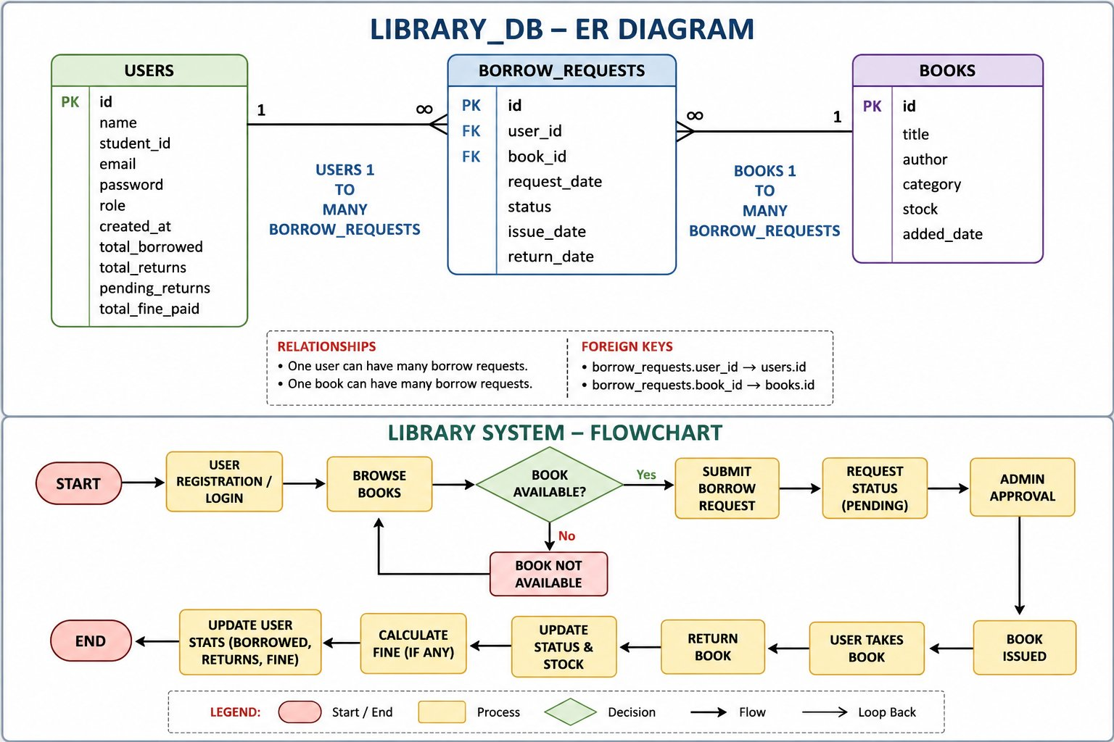
DATABASE DESIGN
ER Diagram & Schema

Slide 7
DATABASE SCHEMA
USERS
BOOKS
BORROW_REQUESTS
id (PK)
id (PK)
id (PK)
name
title
user_id (FK)
student_id
author
book_id (FK)
email
category
status
role
stock
issue_date
total_borrowed
added_date
return_date
total_fine_paid

Slide 8
SYSTEM WORKFLOW
User Login /
Register
Browse
Books
Submit
Borrow Request
Admin
Approval
Book
Available?
Yes →
No ↓
Book Not Available
→ Browse Again
END
Update
Stats
Calculate
Fine
Return
Book
Book
Issued

Slide 9
IMPLEMENTATION
FRONTEND
BACKEND
DATABASE
HARDWARE
HTML5 — Structure & markup
PHP — Server-side scripting
MySQL / PostgreSQL — RDBMS
CPU: Dual-core 2.0 GHz+
CSS3 — Styling & layout
REST API — Client-server comm.
SQL — Queries & procedures
RAM: 4 GB minimum
JavaScript — Interactivity
Session Management — Auth
3NF Normalized Schema
Storage: 100 MB for DB

Slide 10
PROJECT TIMELINE
Week 1
Week 2
Week 3
Week 4
Requirement Analysis & ER Modeling
Schema Normalization & SQL Implementation
Backend Logic & Query Optimization
Frontend Integration & Final Testing
Define system scope
Build DB tables
PHP backend logic
UI & test & deploy

Slide 11

OUTCOMES & CHALLENGES
✓ EXPECTED OUTCOMES
⚠ CHALLENGES
Fully functional relational schema with referential integrity
• Complex fine logic edge cases
• Concurrency in stock updates
User-friendly interface for librarians to manage inventory
• Ensuring RBAC security
Automated fine calculation & overdue reports
🚀 FUTURE IMPROVEMENTS
~60% reduction in administrative overhead
→ E-book & digital resource support
Scalable platform for future digital enhancements
→ SMS / Email auto-notifications
→ AI-powered book recommendations

Slide 12
CONCLUSION
The Integrated Library Management System (ILMS) represents a vital step toward fully digitizing academic library operations. By leveraging a well-designed relational database and a clean PHP-based interface, the system will eliminate manual errors, centralize data, and provide a scalable foundation for future enhancements such as e-book integration and automated notification systems.
60%
3NF
4
Admin Effort
Reduced
Normalized
Schema
System
Modules
Primeasia University • CSE Department • May 2026

Slide 13

THANK YOU
for your time & attention
We welcome your Questions!
Integrated Library Management System (ILMS)
CSE Department • Primeasia University • May 2026

